Slide 1
Protection & Permanency Standards of Practice (SOP) Manual
Released July 1, 2022

Slide 2
This is the home page for the new SOP manual. The chapters are grouped by topic and are accessible by clicking on the Chapter links.

Slide 3
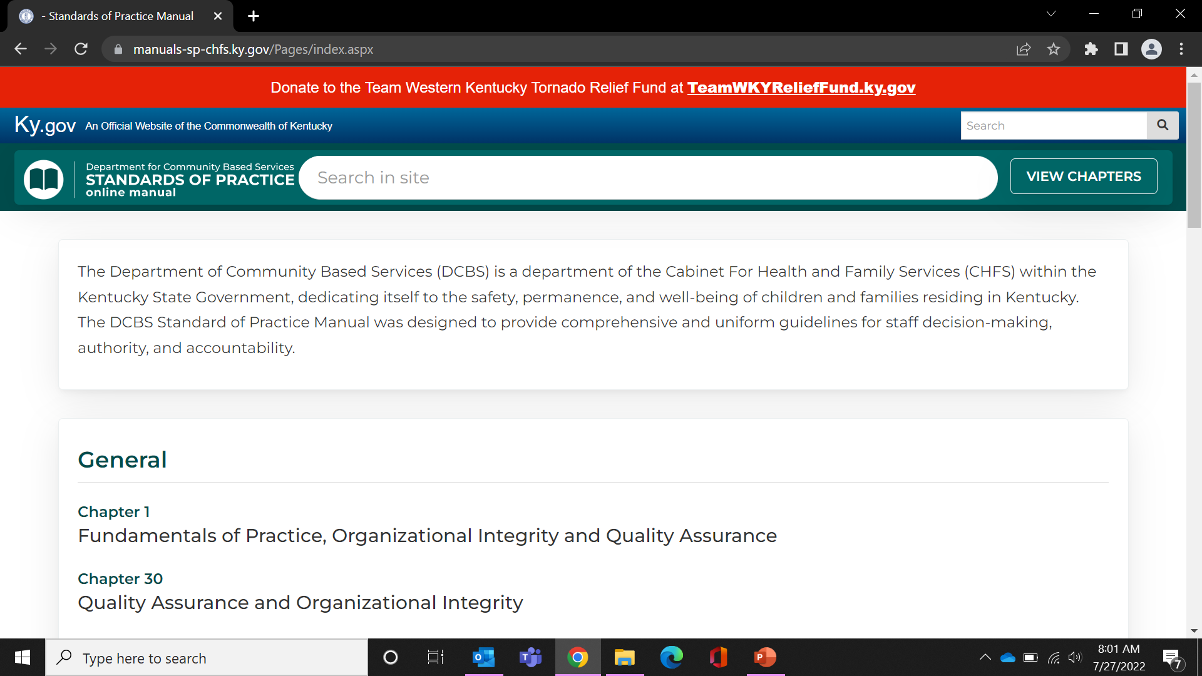
This search area will pull up information within the KY.GOV website (not the SOP manual).
Clicking here from anywhere in the SOP manual will bring you back to the ‘home’ page of the SOP manual.
This area allows you to search within the SOP manual. Typing a couple of words should pull up everything containing those words.

Slide 4
Clicking here from anywhere in the SOP manual will take you to the table of contents.

Slide 5
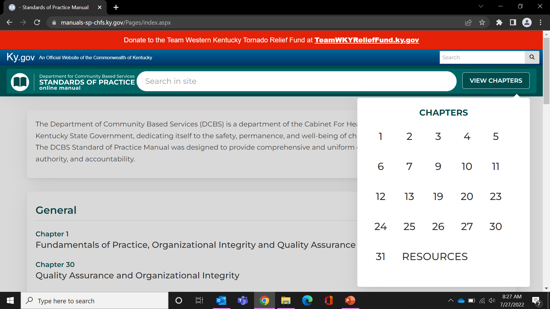
Clicking the individual chapter numbers or the Chapter names will take you to the chapter contents.
(*see results on the next slide)

Slide 7
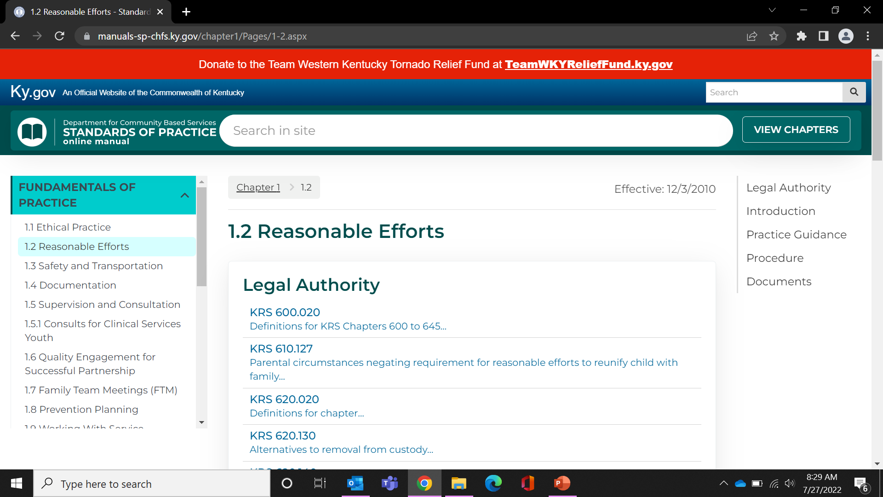
The manual contains easy links within the SOP chapter including the documents associated within the chapter.

Slide 8
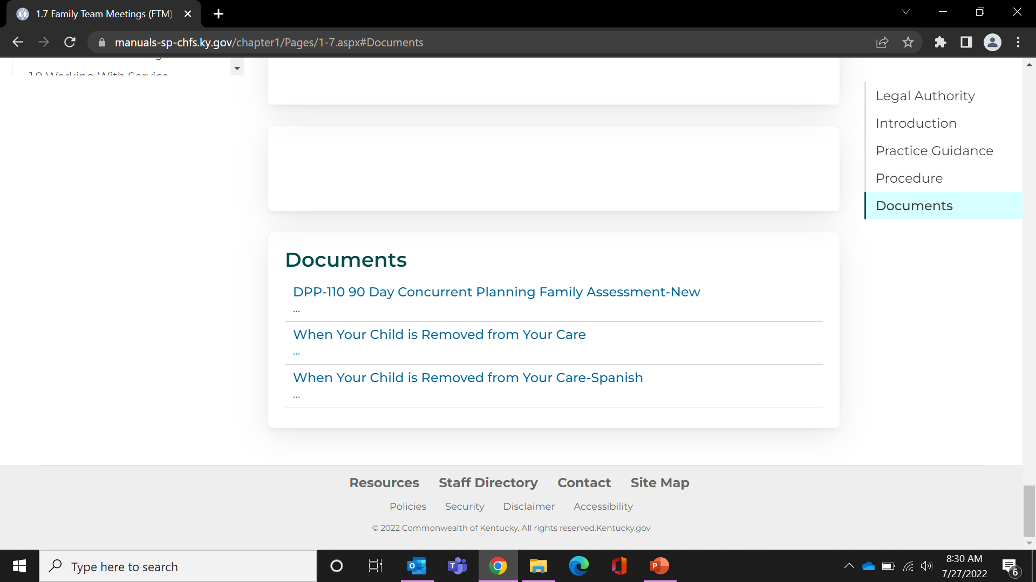
We are experiencing some documents with broken links when attempting to access from within specific chapters. We ask that you notify Julie Cubert and Melanie Daniels when this occurs.

Slide 9
In the meantime, you may click on resources which will allow you to search for your form.

Slide 10
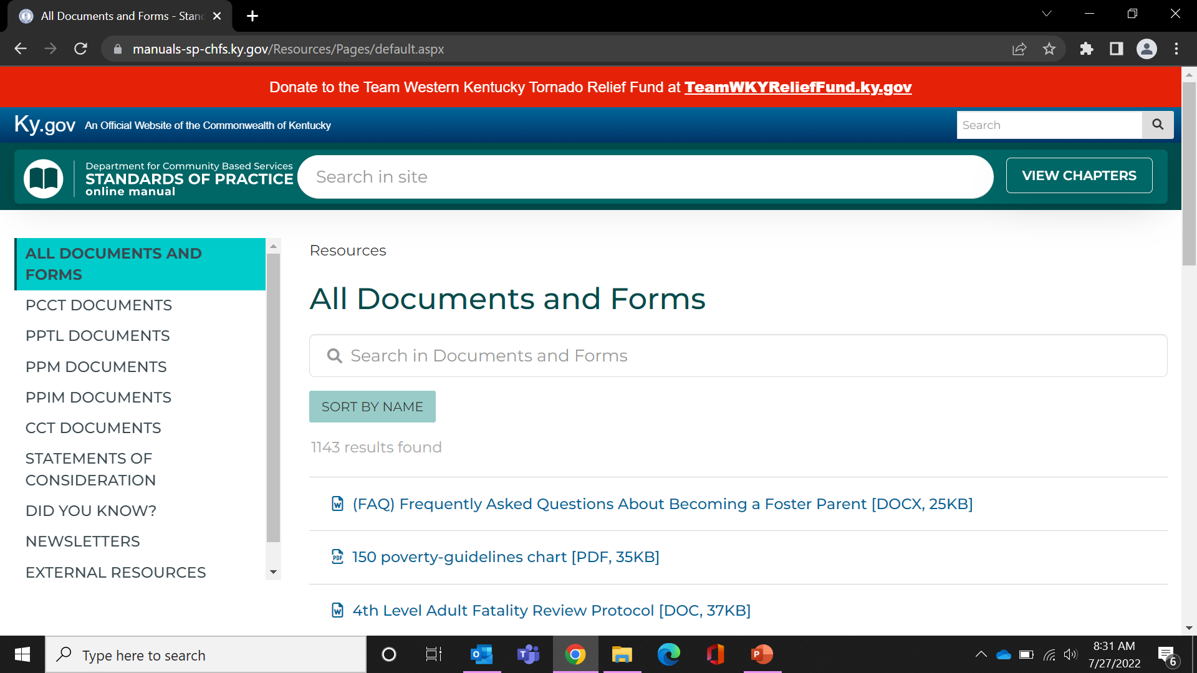
This is the area to type the name or number of the form you need. Simply typing a word associated with your form will yield results specific to your search. The ‘sort by name’ button has been added for ease as well. *Remember, the ‘search in site’ is for topics in SOP while the ‘search in documents and forms’ is specific for your form search.

Slide 11
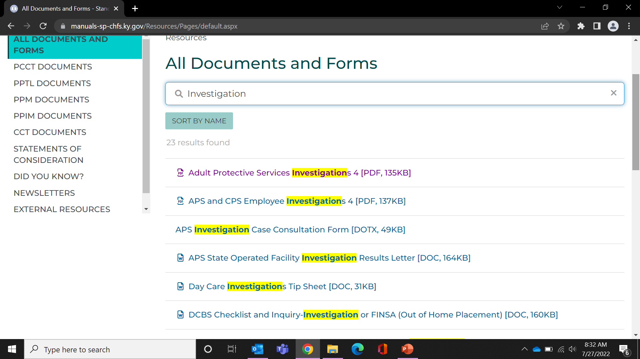
An example is a search for forms associated with ‘investigation’. If this yields too many options or you do not see the form you need, try another word associated with your form or specifically, the form number.

Slide 12
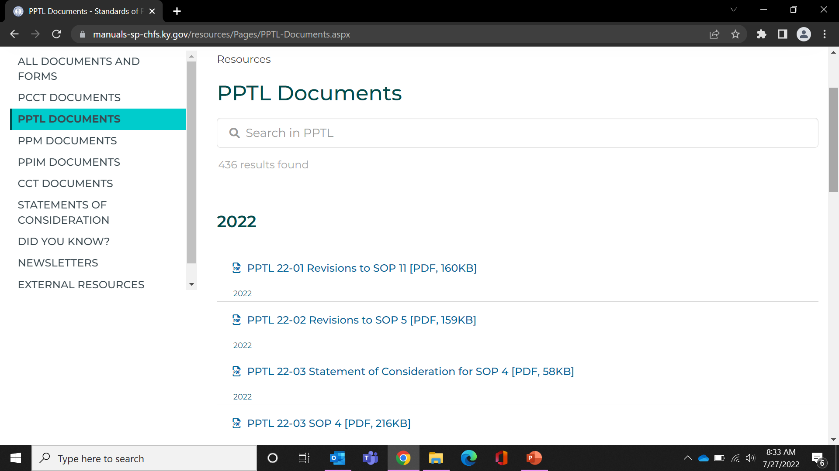
We continue to add memos to the new SOP manual. The memos are categorized by year. If you need a specific PCCT, PPTL, PPM, PPIM, CCT, SOC, DYK, Newsletter, or other resource that is not listed, please notify Julie Cubert and Melanie Daniels. If you find a link within the memo is not working, please let us know as well. Due to the massive amount of data transferred from the previous SOP manual, several things may not be showing at this time. Julie Cubert and Melanie Daniels continue to update the new SOP manual with the content staff needs.

